Slide 1





Dag’s Adventure
STORY
PLAY
HOW TO PLAY
EXIT

Slide 2
GAME OVER
RETRY
MENU
EXIT

Slide 3
CONGRATULATIONS!
PLAY AGAIN
MENU
EXIT

Slide 4

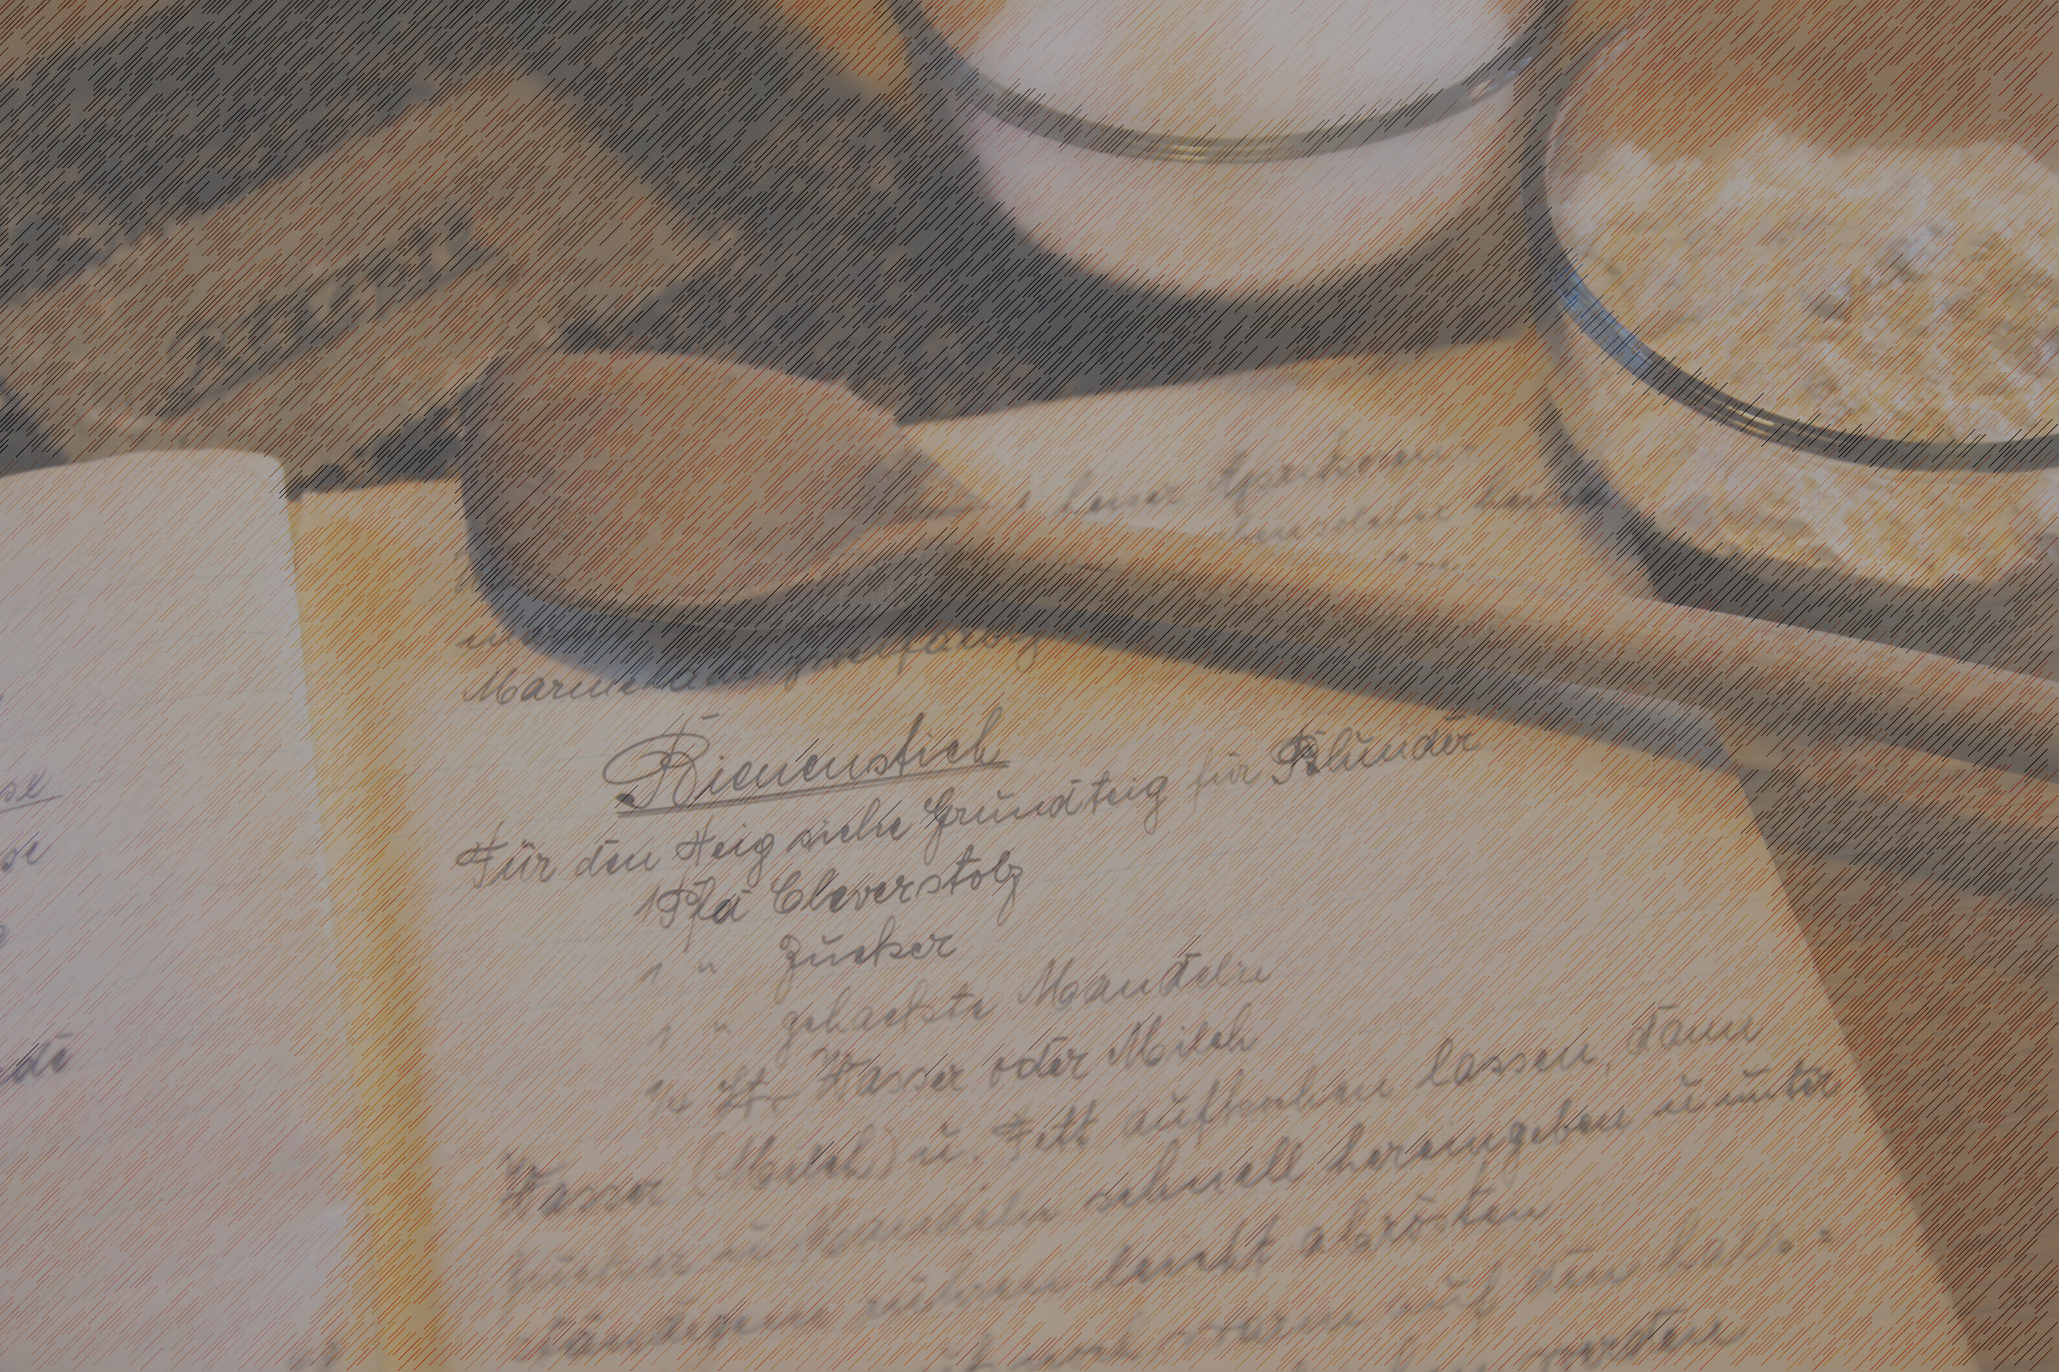
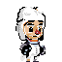
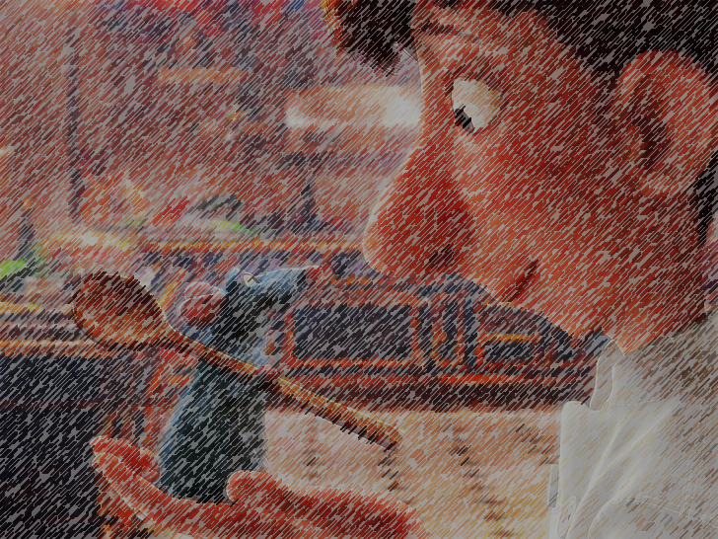
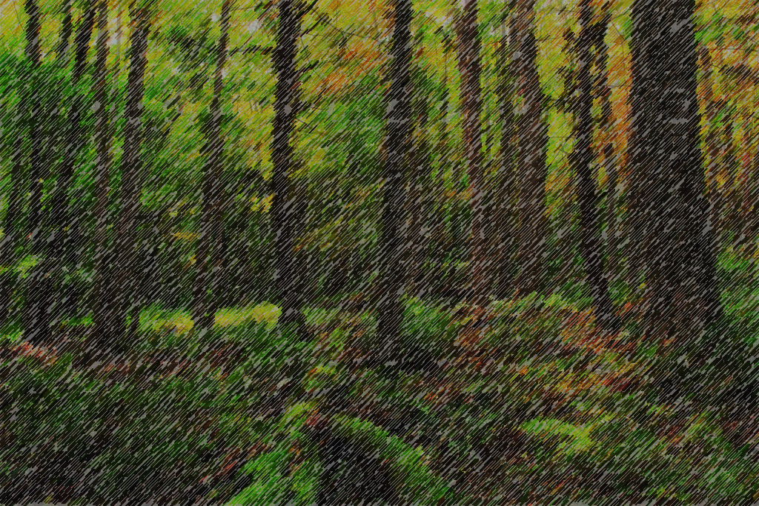

1
Storyline
001
002
Dangerous Dag is a professional pie connoisseur working at a fancy restaurant in town.
But that isn’t the end for him, he has always been searching for the most perfect pie in the world.
“There must be a record of it somewhere” – Dag said to himself everyday
003
004
One day, he heard from a new work mate about the whereabouts of the thing he has been pursuing.
Nothing could stop Dag, he ventured into the forest hoping to find the perfect pie.
“The best pie is in the southwest forest, but you must be careful venturing in there as there are many dangerous obstacles to get to it, and many other types of pie! – Dag’s work mate warned him

Slide 5


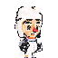
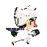

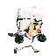




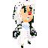
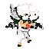

2
Character Description
001
002
Our main character – Dag, is a baker, who is capable of a few other things and can pick up pies.
Run
003
004
Jump
Shoot

Slide 6
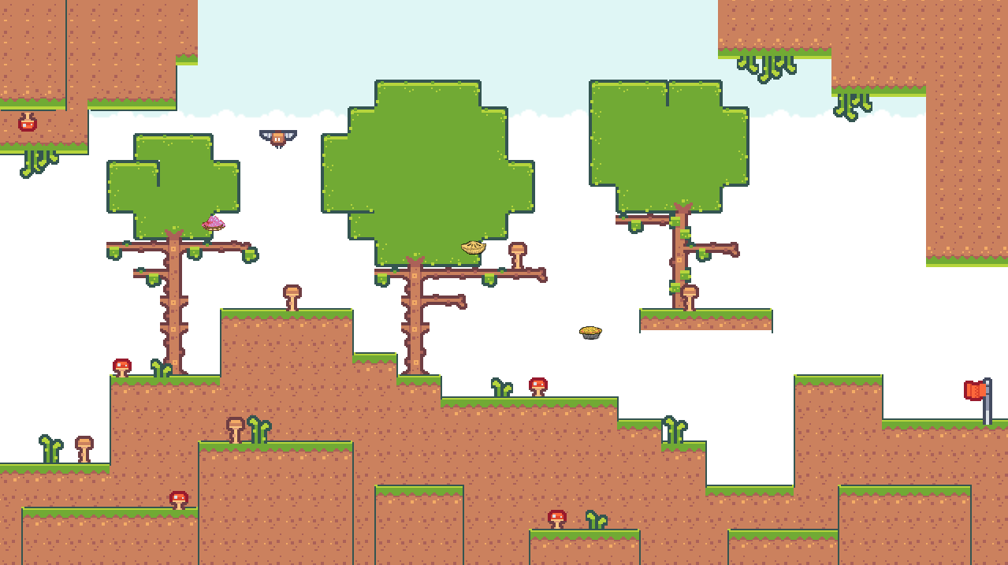
3
Level and Environment Design – Level 1
Theme: Native Forest – Trees and plants
001
002
Objectives
World Complete Area
003
004

Slide 7
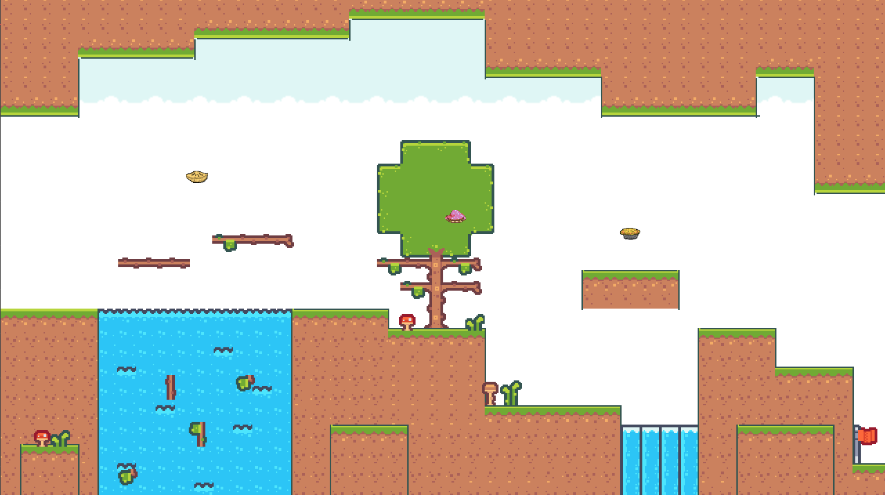
4
Level and Environment Design – Level 2
Objectives
World Complete Area

Slide 8
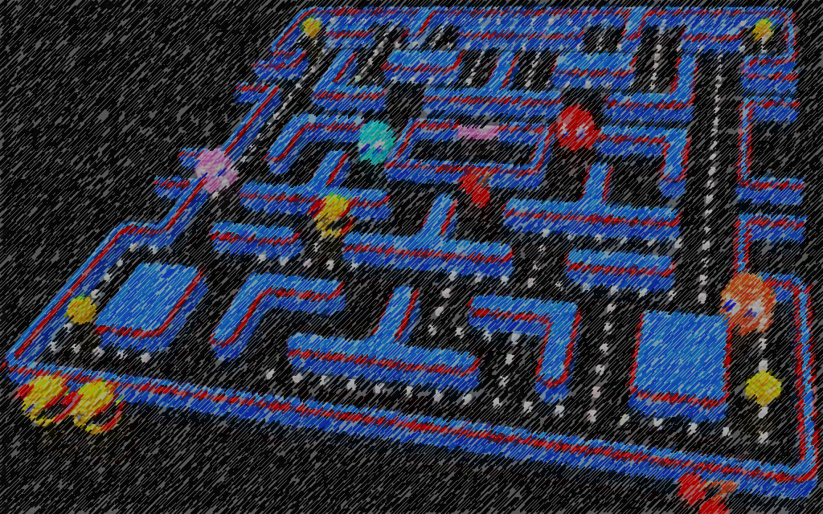
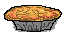



5
Game Play, Art, Sound and Music
Game Play:
Main idea: Jumping platform
Influence: Forest theme with a lot of trees, grass, plants -> branches that the player can jump on to collect the pies. Player will die if he falls down a river, waterfall or touch a bat.
There are 3 types of pies and player must collect all three to advance to the next level
Art
Sprite was provided.
Tiles and other sprites are pixel and they are all related to forest theme like mushrooms, grass and dirt.
Sound: SFXs like
Thud of impact
Walking on grass
Object pick up sound
World completion sound
Death sound
Music: Forest ambience music

Slide 9


6
User Interface Layout
User can use arrow keys on their keyboard to move the player around:
Left key: go left
Right key: go right
Up key: jump
World Complete Area
Player

Slide 10

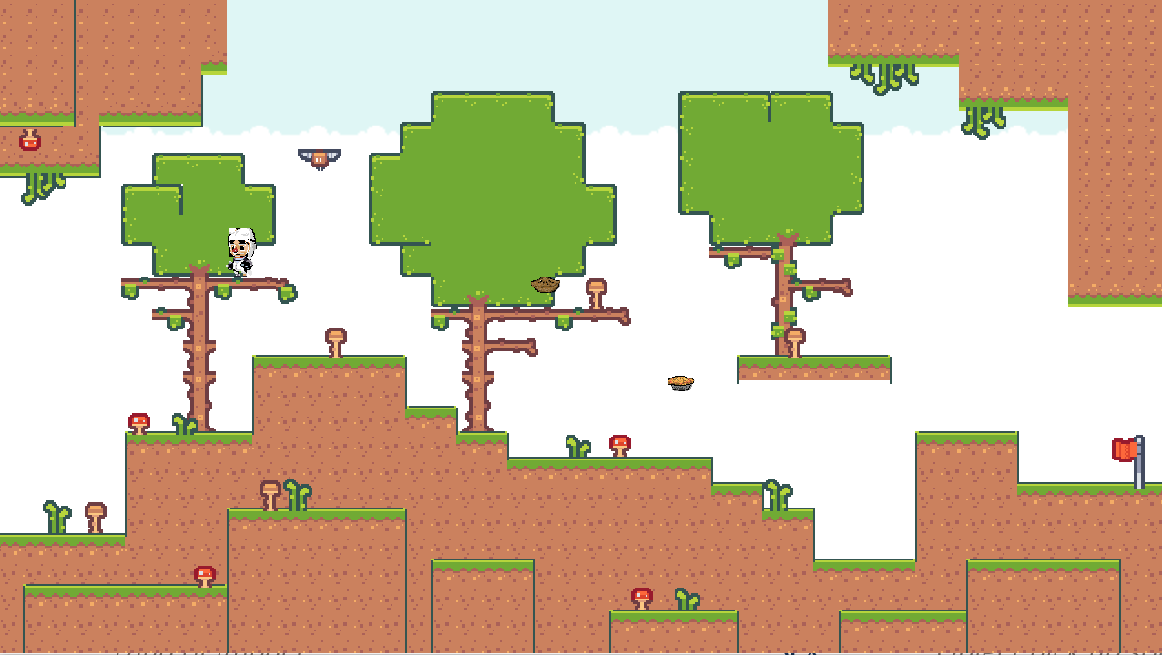




6
Scripting and Storyboards – Level 1
001
002
003
[Player] jumps on a platform, then a tree branch.
[Player] picks up a pie on the tree.
[Player] runs on the platform
“This must be the best mince pie I have ever had”
Thud of impact
Object pick up sound
Running on grass sound
004
005
006
[Player] jumps on a branch and acquires another pie
[Player] picks up another pie and lands on the ground
[Player] heads for the world complete mark. Changing to world 2.
“Hmm, this steak and cheese is quite tasty!”
“Butter chicken pies are not really my favorites.”
“That was quite a dangerous area. Glad I made it through!”
Thud of impact and object pick up sound
Object pick up sound and thud of impact

Slide 11
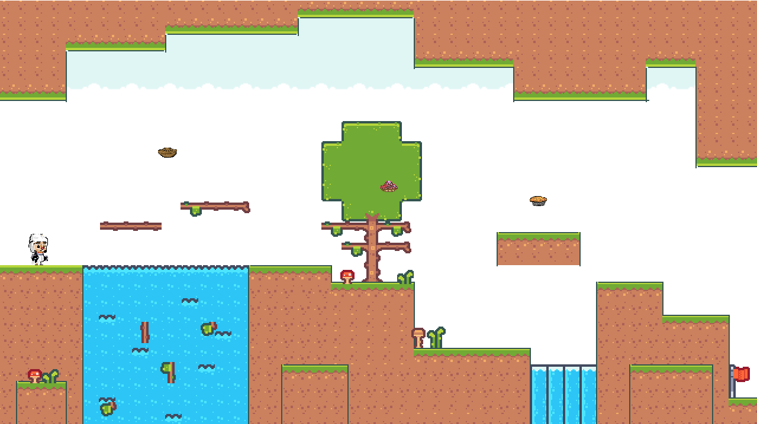





7
Scripting and Storyboards – Level 2
001
002
003
[Player] lands on the new world
[Player] jumps on a branch and acquires a pie
[Player] jumps on another tree and picks up another pie
“I wonder what is waiting for me ahead”
“There’s nothing special about this steak and cheese”
“Tasty!”
Thud of impact
Thud of impact and object pick up sound
Thud of impact and object pick up sound
004
005
006
Game
Completed!
[Player] jumps on a platform and picks up a pie
[Player] jumps on the next platform and heads for the world complete mark
[Player] reaches the mark, thus complete level 2
“This completely changed my mind about butter chicken pies!”
“I have found the perfect pie!”
Thud of impact and object pick up sound
Thud of impact and running on grass sound
World complete sound

Slide 12
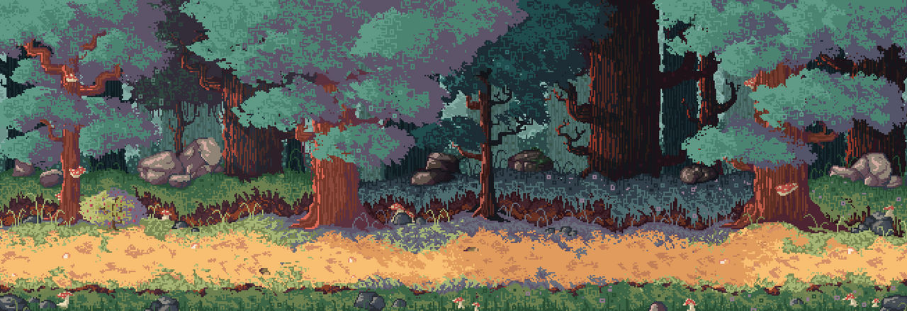
The end

Slide 14

Yeah, I’m ready
X
No, not yet
LIVES:

Slide 15

Story
Dangerous Dag is a professional pie connoisseur working at a fancy restaurant in town. But that isn’t the end for him, he has always been searching for the most perfect pie in the world.
One day, he heard from a new work mate about the whereabouts of the thing he has been pursuing. Nothing could stop Dag, he ventured into the forest hoping to find the perfect pie.
BACK

Slide 16
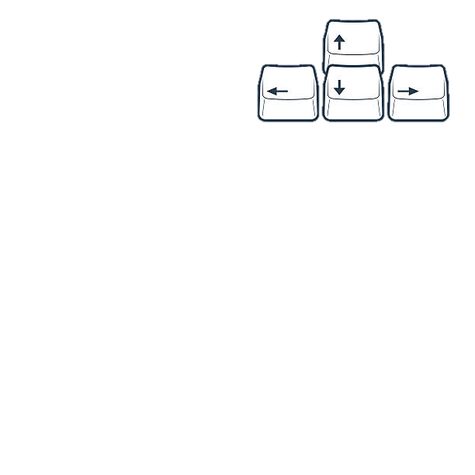


Controls
Use arrow keys to move left, right and jump (up key)
Press Shift to shoot fireballs
Press Enter to interact with objects and people.
BACK
NEXT

Slide 17
Objective
You need to collect all 3 pies in total to advance to the next level, which can be done by interacting with the flag at the end of each level.
Trying to go to the next level without having collected all of them will result in a game over.
BACK
NEXT

Slide 18
Obstacles
You have 3 lives, and you will lose one whenever you get hit by a bat. You will have to start again from the beginning if you lose all 3 lives.
Falling off the platform will result in a game over as well.
BACK
MENU

